Slide 1


FINANCIAL
ANALYSIS
By
Nithish Bodakunti

Slide 2


Table of Contents
Project Overview
Problem
Process
Insights
Dashboards
Summary

Slide 3

Understanding and studying the companies in market through finance attributes.
Analysing the performance and competition in market for better results.
Finding key metrics and relationships to provide insights for better performance .
Project Overview

Slide 4

Problem
Analysing the competition and performance of different companies .

Slide 5
Process
1
Problem Statement
2
Extracting and Studying Data
3
Converting and Cleaning Data
4
Analysing Data
5
Visualising Data

Slide 6

Insights
IOCL and Reliance industries are leading the sales.
Startups like Vedanta and others are performing good.
HDFC Bank has registered low sale comparatively SBI bank.

Slide 7
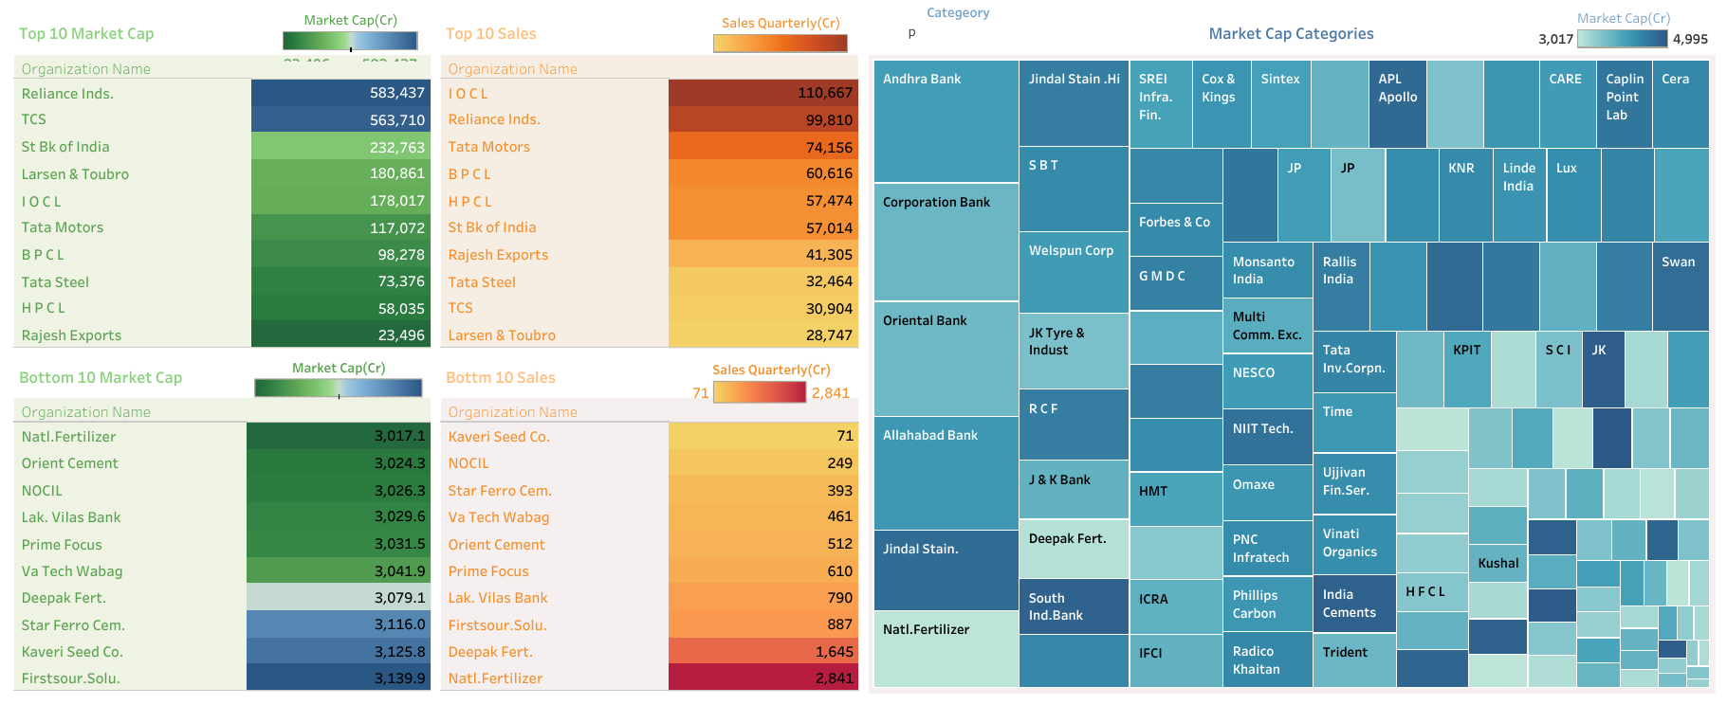
Stand Out List and Categorical Division

Slide 8
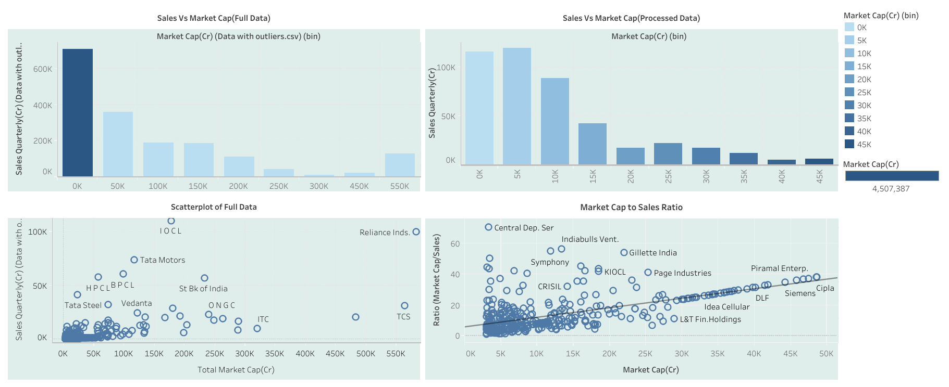
Sales and Market Cap

Slide 9

Oil companies like IOCL, BPCL, HPCL comparatively having smaller market caps than Reliance Industries are performing equally to it and IOCL is leading sales.
Majority of the companies are under the trend line which implies market is in good condition but sales of large cap companies is slightly disappointing .
Under 10k crore market is highly dense but this has positive result towards economy as majority are under trend line.
Summary

Slide 10
Thank you!
ANY QUESTIONS?
Mail Id:
nithishbodapunti12@gmail.com

